Slide 1
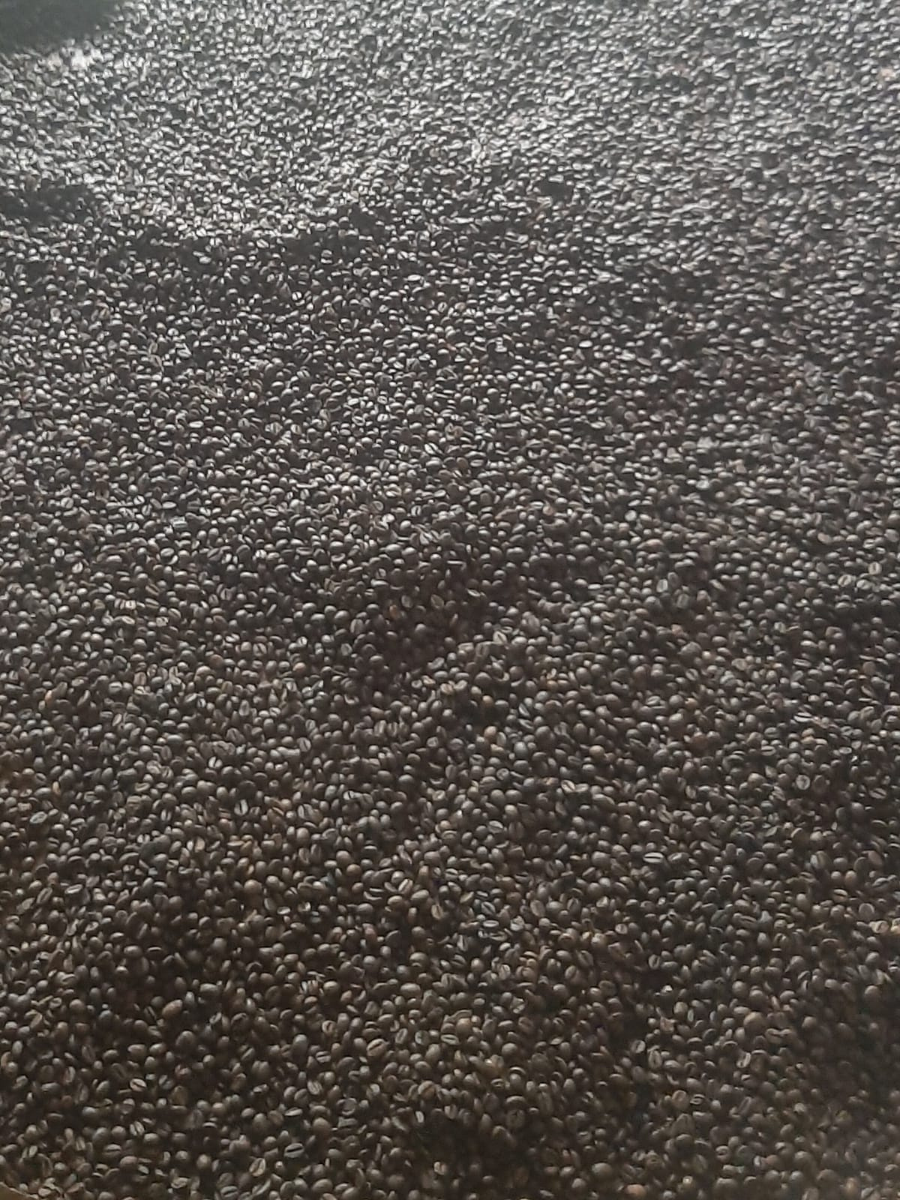

PT AROMA KOPI TORAJA
COMPANY PROFILE
Premium Heritage Coffee from the Highlands of Toraja
www.aromakopitoraja.org
Notes:
Open the deck. PT Aroma Kopi Toraja — a premium heritage coffee company from the highlands of Toraja, South Sulawesi.

Slide 2
OVERVIEW
Table of Contents
01
About the Company
02
Our Vision
03
Our Mission
04
Company Legality
05
Product Description
06
Benefits of the Offer
07
Order & Payment System
08
Thank You
02 / 10
Notes:
Walk through the structure of the profile — eight sections from company background to closing.

Slide 3
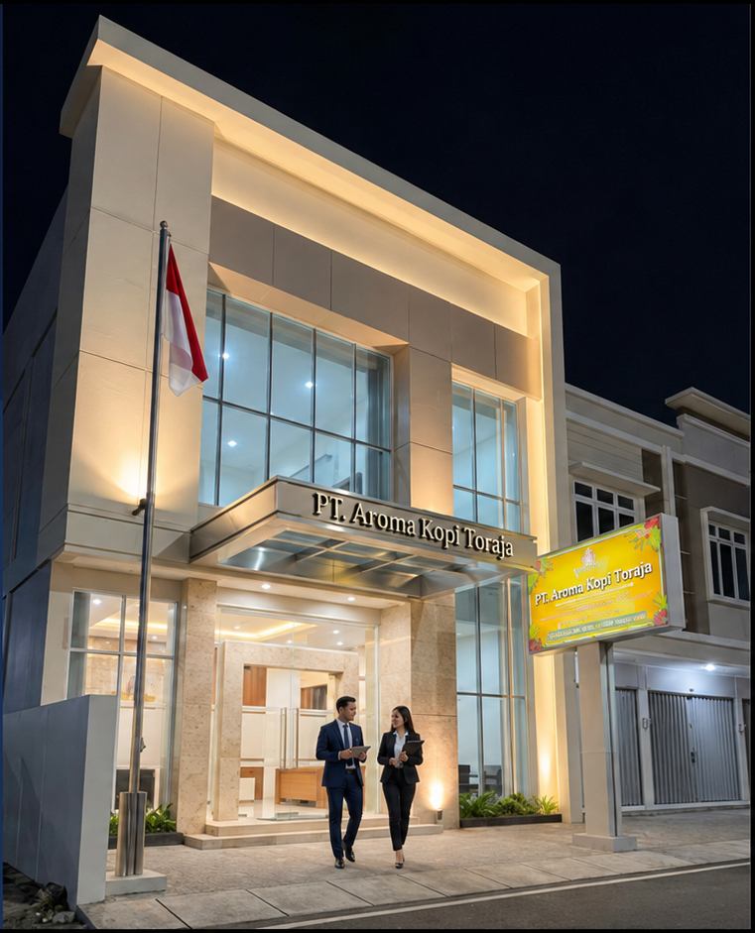
01 — ABOUT THE COMPANY
About the Company
Rooted in the highlands of Tana Toraja, we cultivate and produce specialty Indonesian coffee with a heritage of quality and an authentic single-origin character.
COMPANY NAME
PT Aroma Kopi Toraja
BUSINESS FIELD
Coffee Producer
YEAR ESTABLISHED
2023
ADDRESS
Jl. Poros Makale – Rantepao, Lembang Tallulolo, North Toraja District, South Sulawesi Province
Notes:
Company background. PT Aroma Kopi Toraja, a coffee producer established 2023 in North Toraja, South Sulawesi.

Slide 4
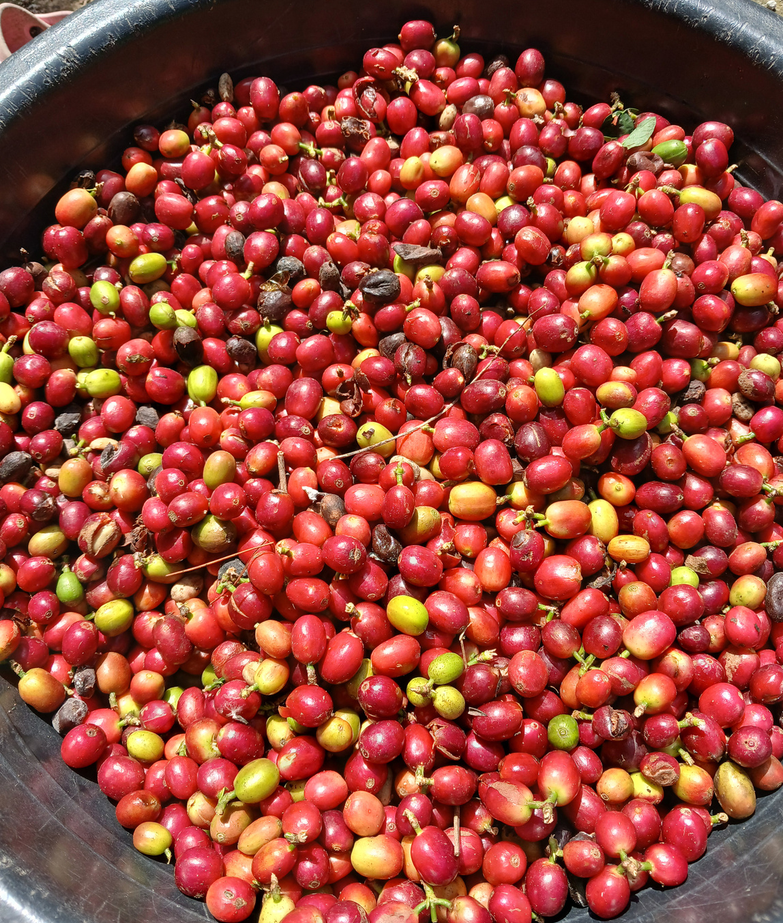
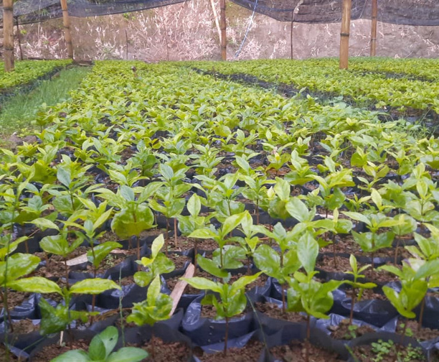
02 — OUR VISION
To become a leading national agribusiness company with global competitiveness.
Growing from authentic Toraja roots toward a sustainable, internationally competitive coffee enterprise.
04 / 10
Notes:
State the vision clearly: a leading national agribusiness company with global competitiveness.

Slide 5

03 — OUR MISSION
Our Mission
01
Develop and produce high-quality products
02
Develop good governance through continuous improvement and investment
03
Develop an organizational culture through competent human resources
04
Participate in preserving the environment and providing benefits to the surrounding area
05
Expand business partnership networks with relevant institutions
05 / 10
Notes:
Five missions: quality products, good governance, organizational culture, environment, and partnership networks.

Slide 6

04 — COMPANY LEGALITY
Company Legality
Company Deed of Establishment
Business Identification Number (NIB)
Operating as a fully registered Indonesian business, supported by the official documents below.
REGISTERED LEGAL DOCUMENT
REGISTERED LEGAL DOCUMENT
Taxpayer Identification Number (NPWP)
PIRT Certificate
REGISTERED LEGAL DOCUMENT
REGISTERED LEGAL DOCUMENT
06 / 10
Notes:
Legal standing: registered Indonesian company with deed of establishment, NIB, NPWP and PIRT certificate.

Slide 7
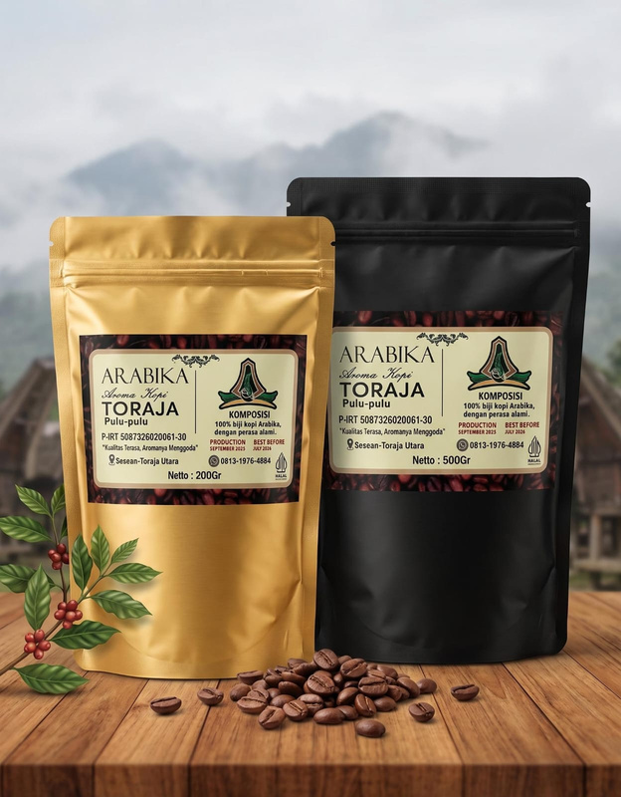
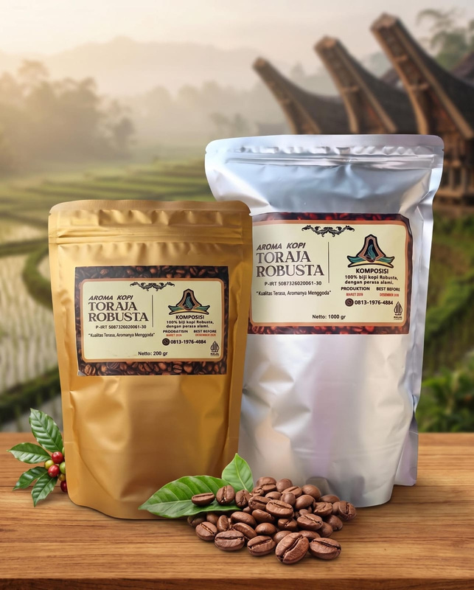
05 — PRODUCT DESCRIPTION
Product Description
BEAN SELECTION
◆
ROASTING
◆
GRINDING
◆
HYGIENIC PACKAGING
Our coffee products are processed through stages of bean selection, roasting, grinding, and hygienic packaging to ensure the best quality reaches consumers.
VARIETY 01
VARIETY 02
Arabica
Robusta
Balanced acidity, floral aroma, medium body, smooth texture, and a clean aftertaste.
Low acidity, thick body, strong bitter aftertaste, with bitter-chocolate and nutty aromas.
OUR PRODUCTS
Green Bean
Roasted Bean
Ground Coffee
Toraja Arabica coffee is recognized under Geographical Indication (GI) protection.
Notes:
Process: bean selection, roasting, grinding, hygienic packaging. Two varieties — Arabica and Robusta. Products: green bean, roasted bean, ground coffee. Toraja Arabica carries GI protection.

Slide 8

06 — THE OFFER
Benefits of the Proposed Offer
01
02
Selected coffee beans sourced directly from farmers
Consistent quality and taste in every batch
03
04
Flexible to meet partner needs
Competitive pricing & long-term partnership benefits
08 / 10
Notes:
Four benefits: farmer-direct selected beans, consistent quality, flexibility for partners, and competitive pricing for long-term partnership.

Slide 9



0 7 — O R D E R & P A Y M E N T S Y S T E M
Order & Payment System
1
2
3
4
Order
Confirmation
Payment
Arrangement
Production
Coordination
Delivery
Coordination
A C C E P T E D P A Y M E N T M E T H O D S
Telegraphic Transfer
Letter of Credit
Bank Transfer
International wire transfer (TT) via the SWIFT
network
In accordance with International Chamber of
Commerce standards
Via Bank Rakyat Indonesia (BRI)
Notes:
Transaction flow in four steps, and three accepted payment methods: TT, LC per ICC standards, and bank transfer via BRI.

Slide 10

THANK YOU
We are committed to delivering the finest Indonesian coffee — especially from Toraja — with consistent quality and reliable service, and we look forward to building long-term partnerships with clients worldwide.
Let's Build a Long-Term Coffee Partnership
PHONE
EMAIL
WEBSITE
INSTAGRAM
+62 813-1976-4884
aromakopitoraja@gmail.com
www.aromakopitoraja.org
@aroma_kopitoraja
Notes:
Close warmly with the partnership message and full contact details. Invite a long-term coffee partnership.

